Slide 1





ADVANCED CCTV ANALYTICS SOLUTION
PS CODE: KVH-009
Team Name : Great Eye

Slide 2




TABLE OF
CONTENT
01
PROBLEM STATEMENT
IMPORTANCE OF CCTV SURVEILLANCE
02
OBJECTIVE
03
SOLUTION
04
FUTURE SCOPE
05
OUR TEAM
06

Slide 3



PROBLEM STATEMENT
Design and develop a technological solution based on live CCTV feeds, that can automatically detect incidents related to street crime, violence, burglary, theft, infiltration, unauthorized access etc. and generate alerts to the nearest Police Station. The solution should also be able to generate a report and maintain a database that includes the nature of incident/crime, location, time, level of alert (i.e., low, medium, high risk alert) etc.

Slide 4




IMPORTANCE OF CCTV SURVEILLANCE
CCTV (closed-circuit television) surveillance plays a critical role in modern security and safety practices. The importance of CCTV surveillance can be summarized as follows:
Crime prevention
Enhanced safety
Investigation
Remote monitoring
Employee monitoring
Cost-effective

Slide 5
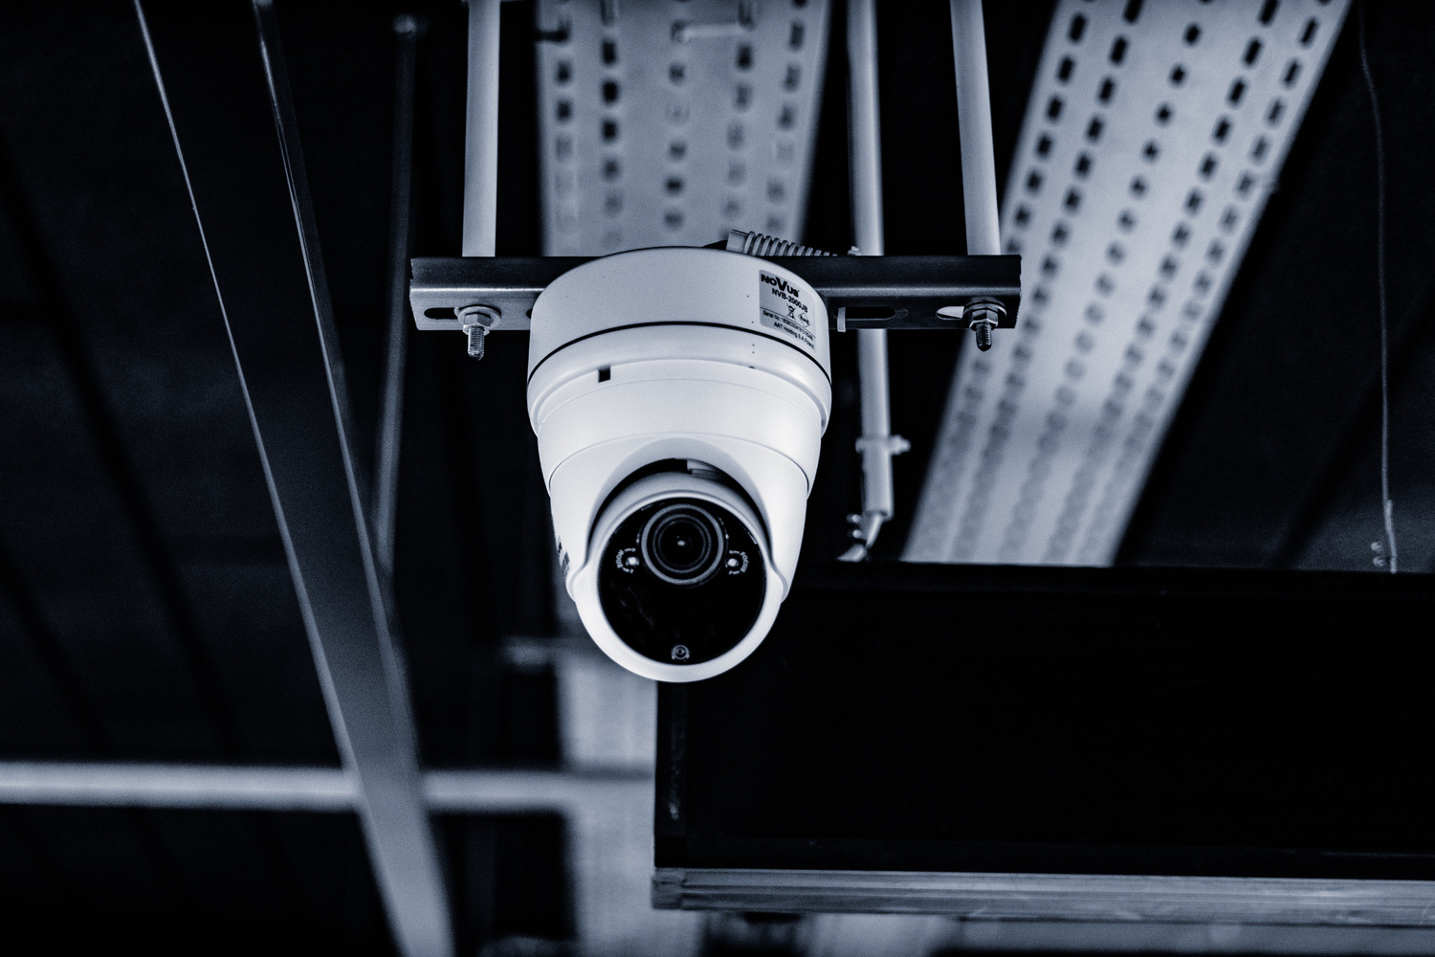

OBJECTIVE
To build and use a deep learning model that will enhance the potential of CCTV in crime detection and prevention with high accuracy. we aim to showcase the advantages of advanced CCTV analytics solutions in terms of improved situational awareness, enhanced response times, and ultimately, better security outcomes.

Slide 6
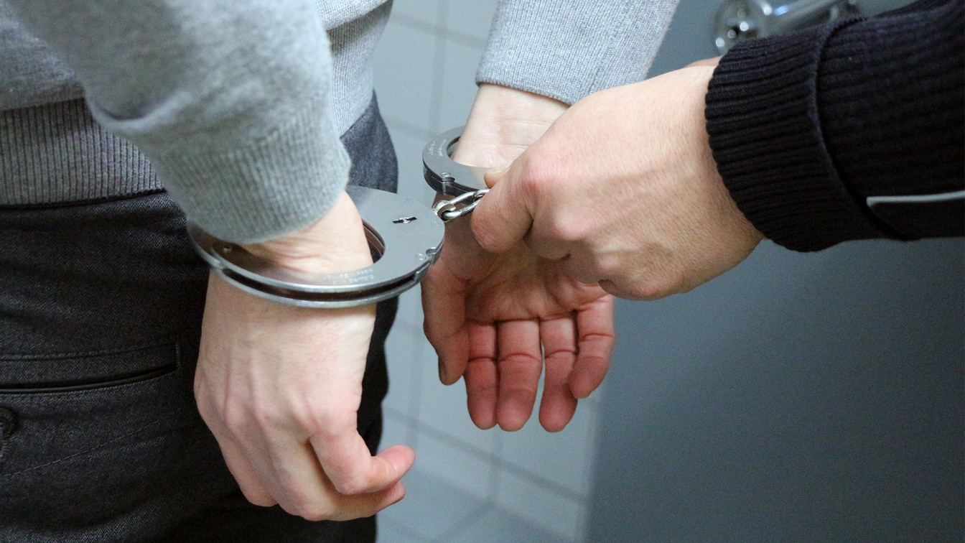

SOLUTION
STEP 1
In our first step, we will convert video to images in real time .
STEP 2
These image will work as input for our deep learning model and provide some outpt with great accuracy..
STEP 3
The classification is under the classes abuse , arrest, arson, assault, burglary, explosion, fighting, normal videos, road accident, robbery, shooting, shoplifting, stealing, vanda}r

Slide 7


FUTURE SCOPE
Advanced CCTV analytics solutions have promising future applications in areas such as object recognition, crowd and traffic management, thermal imaging, and public safety. As these technologies continue to develop, we can expect even more innovative applications to emerge.

Slide 8

OUR TEAM
Aayush Kumarding
Arjun Sharmading
Ankit Kumarding
Devraj Singhding
Kirti Rajpootding
Thank You
Yash Guptang
Team: Great Eye

